Slide 1
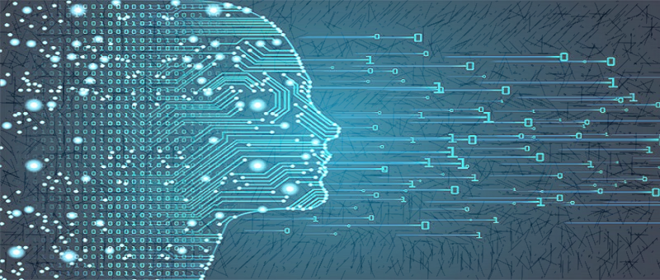
Machine Learning
Process Workflow
This Photo by Unknown Author is licensed under CC BY

Slide 2
Overview
scikit-learn for data and ML modelling
Relationship with Numpy , Pandas, and Matplotlib
Algorithms for supervised and unsupervised learning
Contrast with TensorFlow, KERAS, and other deep learning libraries

Slide 3
Prerequisite
Basic python programming knowledge
For beginners in Machine Learning (ML)
No ML knowledge is required

Slide 4
Outline
Introduction to ML and scikit-learn
ML workflow with scikit learn
Building simple regression model for regression and classification

Slide 5

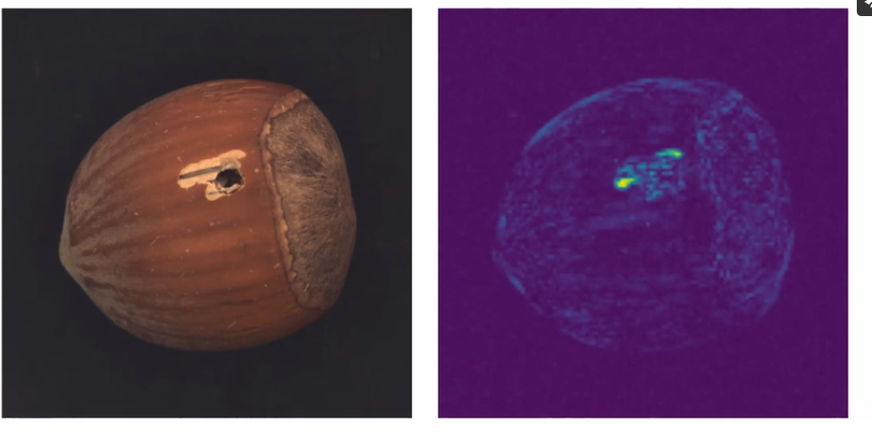
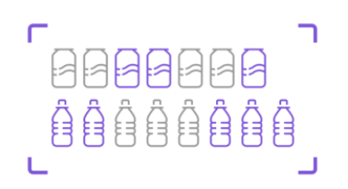

Machine Learning Applications
Virtual Assistant, Chat Bots
Anomaly Detection
Forecasting
Object Detection And Counting

Slide 6
What is Machine Learning ?
Machine Learning is the science (and art) of programming computers so they can learn from data
[Machine Learning is the] field of study that gives computers the ability to learn
without being explicitly programmed.
—Arthur Samuel, 1959
A computer program is said to learn from experience E with respect to some task T
and some performance measure P, if its performance on T, as measured by P, improves
with experience E.
—Tom Mitchell, 1997

Slide 7
A machine learning algorithm is an algorithm that is able to learn from data

Slide 8



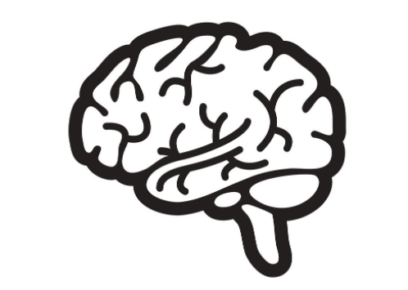
Machine Learning
Works with a huge maze of data
Make intelligent decisions
Find Patterns

Slide 9



Machine Learning
Email on a server
Spam or Ham?
Trash or Inbox

Slide 10




Types of Machine Learning Problems
Dimensionality reduction
Classification
Regression
Clustering

Slide 11
Types of Machine Learning Problems
Dimensionality reduction
Classification
Regression
Clustering

Slide 12


Whales: Fish or Mammals
Fish
(Looks like fish, swim like fish, and move with fish)
Mammals Memebers of infraorder cetacea

Slide 13


Rule-based Binary Classifier
Whale
Mammals
or
Rule-based classifier
Human Experts

Slide 14
Experts know what rules to apply
Rule-based classifier
Human Experts

Slide 15

ML – based Binary Classifiers
Breathes like mammal,
Gives birth like mammal
Mammals
ML-based classifier
CORPUS

Slide 16
ML – based Binary Classifier
Training
Feed in a large corpus of data classified correctly
Prediction
Use it to classify new instances which it has not seen before

Slide 17

Training the ML – Based classifier
Classification
ML-based classifier
CORPUS
Feedback – loss function
Improves model parameters

Slide 18

ML – based Binary Classifiers
Classification Algorithm
ML-based classifier
CORPUS

Slide 19
ML – based Binary Classifiers
Breathes like mammal,
Gives birth like mammal
Mammals
ML-based classifier
Input : Feature Vectors
Output : Label
CORPUS

Slide 20
ML – based Binary Classifiers
Moves like fish,
Swims like fish
Fish
ML-based classifier
Predicted Label
=
Actual Label
Input : Wrong choice of features
CORPUS

Slide 21
Traditional and Representational Machine Learning

Slide 22
ML Based Binary Classifier
Classification Algorithm
ML-based classifier
CORPUS

Slide 23



Specific Algorithm Which Learns From Data
Classification Algorithm
ML-based classifier
CORPUS

Slide 24
Choice of Algorithm Determined by Experts (Data scientists)
Classification Algorithm
ML-based classifier
CORPUS

Slide 25

Features Determined by Experts (Data scientists)
Classification Algorithm
ML-based classifier
CORPUS

Slide 26

Machine Learning Models
Traditional ML Models
Representational ML Models

Slide 27
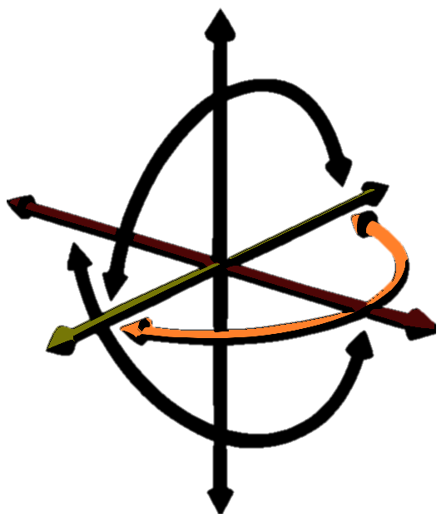
Traditional ML Models
Regression models : Linear, Lasso,
Ridge, SVR
Classification models : Naïve Bayes, SVMs,
Decision Trees, Random Forest
Dimensionality Reduction : Manifold Learning, factor analysis, SVR
Clustering : K - means, DBSCAN, Spectral clustering

Slide 28
Traditional ML Models
Have a fundamental algorithmic structure to solve problems
The algorithm is fed data which train algorithmic parameters
Called model parameters

Slide 29
Traditional ML Models
Build a tree structure to classify instances
Fit a line or a curve on data to make predictions
Apply probabilities on input data to get output probabilities

Slide 30
Traditional ML Models
“Traditional” ML-based system rely on experts to decide what features to pay attention to – and how

Slide 31

Representation ML Models
Also used to solve classification, regression,
Clustering and dimensionality reduction
Learn significant features from underlying data
Deep learning models such as neural network

Slide 32
Representation ML Models
“Representation” ML-based system figure out by themselves what features to pay attention to – and how

Slide 33
What is a Neural Network
Deep Learning
Algorithms that learns what features matter
Neural Networks
The most common class of deep learning
Neurons
Simple building blocks that actually “learn”

Slide 34
Neural Networks
Layer 1
Layer 2
………
Layer N
CORPUS
ML-based classifier
Layers in neural network

Slide 35
Neural Networks
CORPUS
ML-based classifier
Layers in neural network

Slide 36
Neural Networks
CORPUS
ML-based classifier
Each layer consist of individual interconnected neurons

Slide 37

Neural Networks
Pixels
Edges
Corners
Object Parts
ML-based classifier
Layers in neural network
CORPUS

Slide 38
Traditional vs Deep Learning Models
Traditional ML Models
Features used in models explicitly chosen by domain experts
Representational ML Models
Features used in models implicitly chosen by model itself

Slide 39
Traditional vs Deep Learning Models
Traditional ML Models
Features used in models explicitly chosen by domain experts
Structured data such as number and probabilities
Representational ML Models
Features used in models implicitly chosen by model itself
Unstructured data such as images, text and audio

Slide 40
Traditional vs Deep Learning Models
Traditional ML Models
Features used in models explicitly chosen by domain experts
Structured data such as number and probabilities
Classification, regression, clustering and dimensionality reduction
Representational ML Models
Features used in models implicitly chosen by model itself
Unstructured data such as images, text and audio
Classification, regression, clustering and dimensionality reduction

Slide 41
Traditional vs Deep Learning Models
Traditional ML Models
Wide range of problem specific solution techniques
Representational ML Models
Neural network is by far the most common solution technique

Slide 42
Traditional vs Deep Learning Models
Traditional ML Models
Wide range of problem specific solution techniques
Each solution technique adopts characteristic approach
Representational ML Models
Neural network is by far the most common solution technique
All solution techniques rely on neurons and interconnections between them

Slide 43
Traditional vs Deep Learning Models
Traditional ML Models
Wide range of problem specific solution techniques
Each solution technique adopts characteristic approach
User has more insight into mechanics and internals of model
Representational ML Models
Neural network is by far the most common solution technique
All solution techniques rely on neurons and interconnections between them
Black-box models are hard to question and reverse engineer

Slide 44
Traditional vs Deep Learning Models
Traditional ML Models
Wide range of problem specific solution techniques
Each solution technique adopts characteristic approach
User has more insight into mechanics and internals of model
Scikit-learn
Representational ML Models
Neural network is by far the most common solution technique
All solution techniques rely on neurons and interconnections between them
Black-box models are hard to question and reverse engineer
TensorFlow , Keras, PyTorch

Slide 45
Important Concepts in Machine Learning

Slide 46
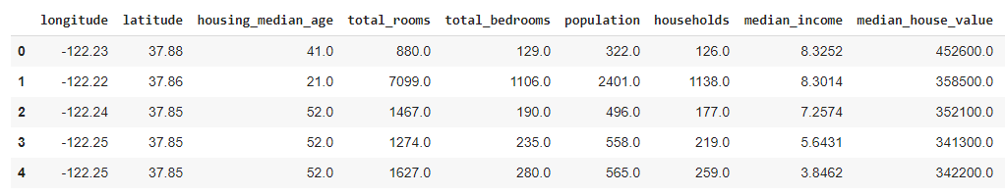
Dataset
Features / Inputs
Target / Output
x
Y

Slide 47
Mathematical Model Analogy
Model
x
Y
Input/features
output/response
Given input and output ; what is the model that best fits the data
f(x) : hypothesis = weights * input + bias
We try to minimise the loss function/error to get best possible fit to the data by updating weight
Error : loss function = g(w)
minimize g(w) to find optimal weights

Slide 48
Data
Without data there is No “Machine Learning”
What is data – “ It can be any unprocessed fact, value, text, sound or picture that is not being interpreted and analyzed” ^{[1]}
Data
Information
Knowledge
Housing Prices in the city
Price Range :
$ 150K to $450K
Price depends on:
# of bedrooms
Distance from city centre
Ocean Vicinity etc.
Courtesy – [1]. analytics india magazine

Slide 49
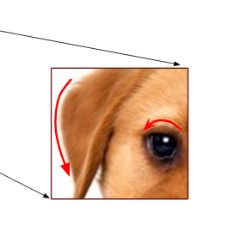
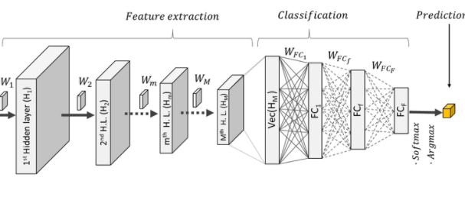
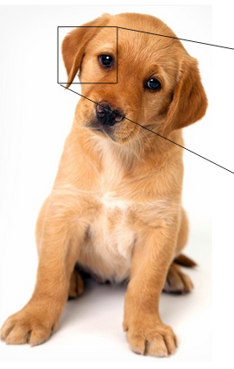
How Data Is Used In ML
Dog
Data
Features
Model
Prediction
text; images; audio; video
Text columns; part of the images
CNN,RNN
Classify document; identify object
NO Data → No business Insight
Useful data → Valuable Insight
Garbage In → Garbage Out

Slide 50
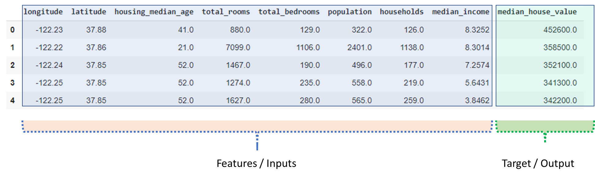
Training Data / Test Data
Dataset
Training
Testing
(Features + Target)
(Features + Target)
(Features + Target)
[50000 x 9]
[40000 x 9]
[10000 x 9]

Slide 51
Training Data / Test Data
Training
Testing
Training
Validation set
(Features + Target)
(Features + Target)
(Features + Target)
[40000 x 9]
[10000 x 9]
[40000 x 9]

Slide 52
Training Data / Test Data
Testing
(Features + Target)
ML Algorithms
[10000 x 9]
Training
Validation set
Select an Algorithm
Evaluate
Final model
(Features + Target)
[40000 x 9]
Save error
Multiple models are trained and one with the minimum error is selected

Slide 53
Training Data / Test Data
Testing
(Target )
Testing
Final model
[10000 x1]
Did model generalise well?
(Features )
Evaluate final results
Predicted Values
[10000 x8]
Multiple models are trained and one with the minimum error is selected

Slide 54
Generalisation Error
Training Error
Testing Error
Model is good
Training Error
Testing Error
Model is overfitting
Training Error
Testing Error
Model is underfitting

Slide 55
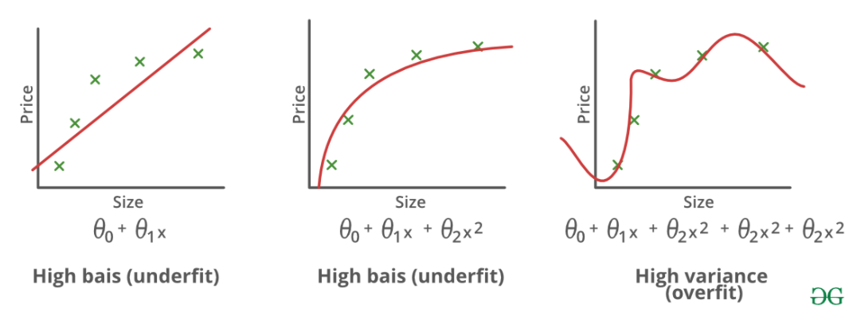
Bias – Variance Tradeoff

Slide 56
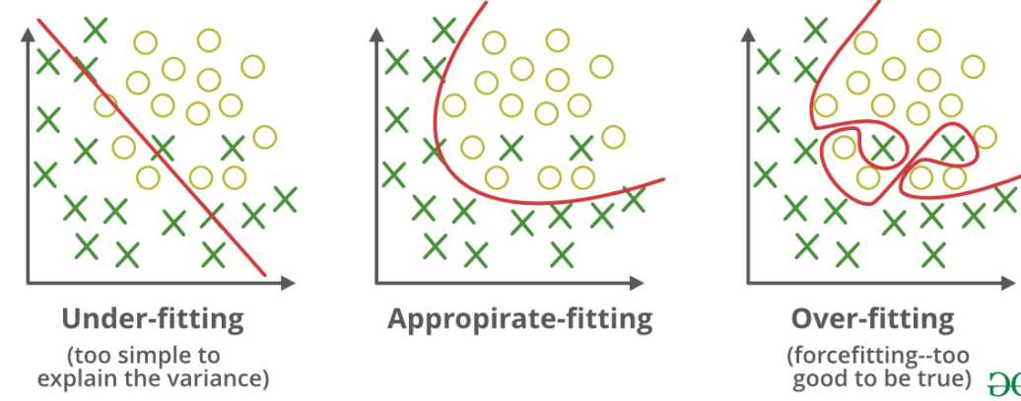
Bias – Variance Tradeoff

Slide 57

Training Data / Test Data
New Data
Final model
(Features )
Predicted Values
Happy Customer/Stakeholder
[10000 x8]

Slide 58
Explore these concept
Bias Variance Trade off
Generalisation Error
Hyperparameter Tuning
Deploying to web/production
Big Data and ML

Slide 59
Bias Variance Tradeoff

Slide 60
MODEL DEMO

Slide 61
THANK YOU!

Slide 62
BACKUP

Slide 63
Data Sources
Databases
Customer transaction data
Webservers
Customer click events on the website
Geolocations and weather centre data
Data collected in different labs
Observatories
NASA; European space agencies, ISRO collect data from space
Genomics
Data collected from DNA samples
Healthcare etc.
Patient health history

Slide 64
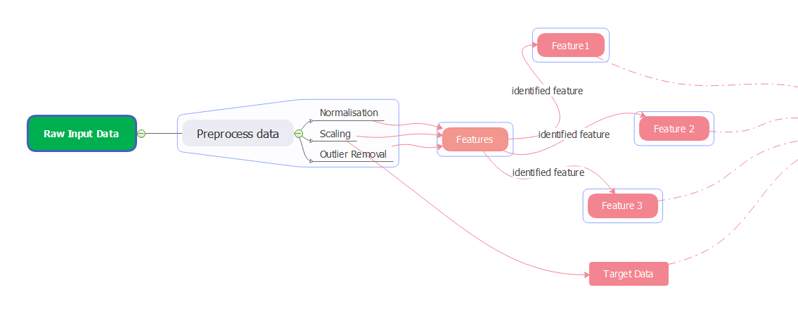
Data Pre-processing And Feature Selection
Identified features are fed to ML model
Clean and Transform
Feature Engineering and selection Phase
ML Model
Data extracted from different sources
Databases
Webservers
Surveys
Sensory data
Observatories

Slide 65
Feature Engineering And Feature Selection
Feature Engineering :
Feature engineering is the act of extracting features from raw data and transforming them into formats that are suitable for the machine learning Model
Feature Selection:
Feature selection techniques prune away non useful features in order to reduce the complexity of the resulting model
Selecting inputs which are more suitable for model and results in better model
Reducing feature does not necessarily reduce training time
Data
Features
Model
Prediction

Slide 66
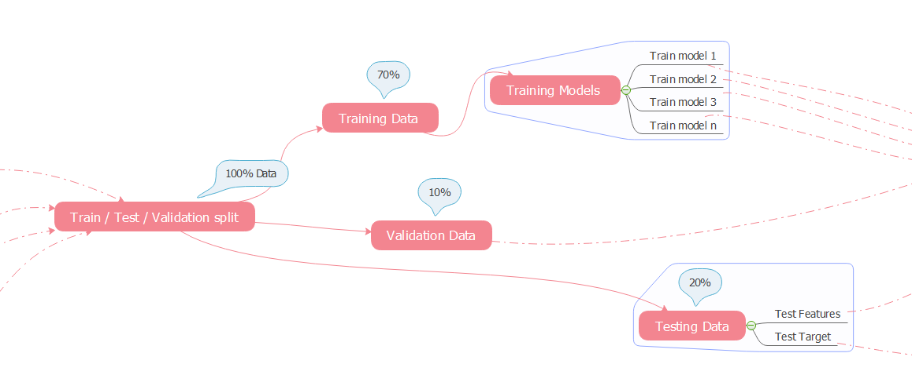
Train/Test /Validation Split
Data is divided into three parts training, validation and testing
Training Set - This part of data is used for training purpose
Validation Set – This is also called as hold out set; it is used for model selection. Different models are evaluated on validation set
Test Set – This data is not used during training; final model is evaluated using test set

Slide 67

Model Training [Finding Model Parameters]

Slide 68
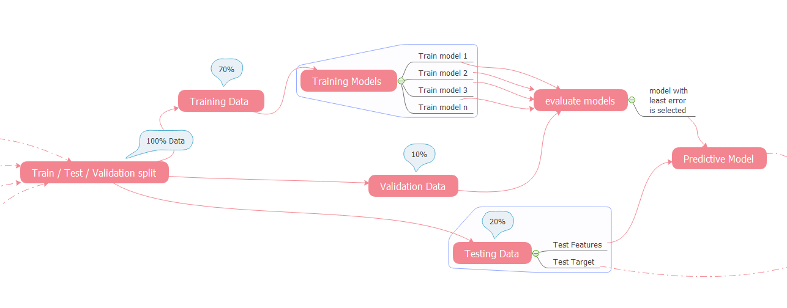
Model Evaluation [Selecting A Model]

Slide 69
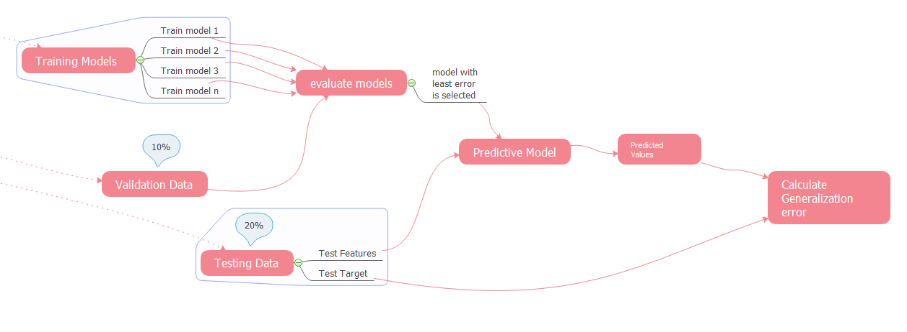
Model Prediction And Generalization (Overfit/Underfit)

Slide 70
What We Learnt Today
What is machine learning
Analogy to Mathematical model
What is Data and how its used to train machine learning models
Machine Learning process workflow
Demo on model parameter and hyperparameter
Underfitting and Overfitting
Model Generalisation

